Slide 1




I⭲lroduclio⭲ lo Neo4j

Slide 2


Slide 3
Today
Concepts
Data modeling
Cypher -reading, writing, aggregation
Vector indexes (if we have time)

Slide 4
Nodes, relalio⭲ships, properlies

Slide 6
Toy Story

Slide 7
Toy Story
Nodes represent things

Slide 8
Toy Story
Nodes represent things
Movie

Slide 9

Nodes can be identified by one or more labels
Nodes represent things
Movie
Toy Story

Slide 10
Nodes can be identified by one or more labels
Nodes represent things
Movie
Animated
Toy Story

Slide 11
Nodes can be identified by one or more labels
Nodes represent things
Movie
Animated
Toy Story
title: Toy Story released: 1995

Slide 12
Nodes can be identified by one or more labels
Nodes represent things
Movie
Animated
Toy Story
Nodes can hold properties
as key/value pairs
title: Toy Story released: 1995

Slide 13
Toy Story
Movie

Slide 14
Actor
Movie
Tom Hanks
Toy Story

Slide 15
Actor
Movie
Tom Hanks
Toy Story

Slide 16
Relationships connect two nodes
Actor
Movie
Tom Hanks
Toy Story

Slide 17
Relationships connect two nodes
Actor
Movie
Tom Hanks
Toy Story
ACTED_IN

Slide 18
Relationships connect two nodes
Relationships have a type
Actor
Movie
Tom Hanks
Toy Story
ACTED_IN

Slide 19
Relationships connect two nodes
Relationships have a type
Actor
Movie
Tom Hanks
Toy Story
ACTED_IN
Relationships have a direction

Slide 20
Relationships connect two nodes
Relationships have a type
Actor
Movie
Tom Hanks
Toy Story
ACTED_IN
roles: Woody
Relationships have a direction

Slide 21
Relationships connect two nodes
Relationships have a type
Actor
Movie
Tom Hanks
Toy Story
ACTED_IN
roles: Woody
Relationships can also hold properties as key/value pairs
Relationships have a direction

Slide 22
Actor
Movie
Tom Hanks
Toy Story
ACTED_IN

Slide 23
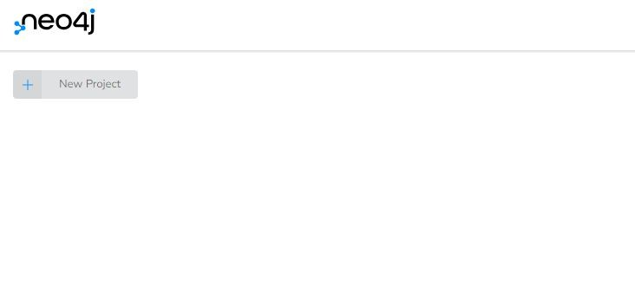


Let’s explore!
New Project
Scroll-down to:
sandbox.neo4j.com
Recommendations
Create

Slide 24
Cypher

Slide 25
Cypher is a declarative language that allows you to identify patterns in your data using an
ASCII-art style syntax consisting of brackets, dashes and arrows.
Person
Movie
ACTED_IN
(p:Person)-[r:ACTED_IN]->(m:Movie)

Slide 26
Cypher is a declarative language that allows you to identify patterns in your data using an
ASCII-art style syntax consisting of brackets, dashes and arrows.

Slide 27
Cypher is a language that allows you
declarative
to identify patterns in your data using an ASCII-art style syntax consisting of brackets, dashes and arrows.

Slide 28
Cypher is a declarative language that allows you
to in your data using an
identify patterns
ASCII-art style syntax consisting of brackets, dashes and arrows.
Person
Movie
ACTED_IN

Slide 29
Cypher is a declarative language that allows you to identify patterns in your data using an
ASCII-art style syntax
consisting of brackets,
dashes and arrows.
Person
Movie
ACTED_IN
(p:Person)-[r:ACTED_IN]->(m:Movie)

Slide 30
Cypher is a declarative language that allows you to identify patterns in your data using an
ASCII-art style syntax consisting of brackets, dashes and arrows.
Person
Movie
ACTED_IN
(p:Person)-[r:ACTED_IN]->(m:Movie)

Slide 31
Cypher is a declarative language that allows you to identify patterns in your data using an
ASCII-art style syntax consisting of brackets, dashes and arrows.
Person
Movie
ACTED_IN
(p:Person)-[r:ACTED_IN]->(m:Movie)

Slide 32
Cypher is a declarative language that allows you to identify patterns in your data using an
ASCII-art style syntax consisting of brackets,
dashes
and arrows.
Person
Movie
ACTED_IN
(p:Person)-[r:ACTED_IN]->(m:Movie)

Slide 33
Cypher is a declarative language that allows you to identify patterns in your data using an
ASCII-art style syntax consisting of brackets,
dashes
and arrows.
Person
Movie
ACTED_IN
(p:Person)-[r:ACTED_IN]->(m:Movie)

Slide 34
Cypher is a declarative language that allows you to identify patterns in your data using an
ASCII-art style syntax consisting of brackets,
dashes
and arrows.
Person
Movie
ACTED_IN
(p:Person)-[r:ACTED_IN]->(m:Movie)

Slide 35
Cypher is a declarative language that allows you to identify patterns in your data using an
ASCII-art style syntax consisting of brackets, dashes and arrows.
Person
Movie
ACTED_IN
(p:Person)-[r:ACTED_IN]->(m:Movie)

Slide 36
Cypher is a declarative language that allows you to identify patterns in your data using an
ASCII-art style syntax consisting of brackets, dashes and arrows.
Person
Movie
ACTED_IN
(p:Person)-[r:ACTED_IN]->(m:Movie)

Slide 37
Readi⭲ą

Slide 38
Reading from Neo4j
// Find a pattern in the database
MATCH
(p:Person)-[r:ACTED_IN]->(m:Movie)

Slide 39
Reading from Neo4j
// Find a pattern in the database
MATCH (p:Person)-[r:ACTED_IN]->(m:Movie)
// Filter on a node property
WHERE
m.title = "Toy Story"

Slide 40
Reading from Neo4j
// Find a pattern in the database
MATCH (p:Person)-[r:ACTED_IN]->(m:Movie)
// Filter on a node property
WHERE m.title = "Toy Story"
// Choose what to return
RETURN
p.name AS actor, r.roles AS roles

Slide 41
Reading from Neo4j
// Find a pattern in the database
MATCH (p:Person)-[r:ACTED_IN]->(m:Movie)
SQL Equivalent
FROM/JOIN
// Filter on a node property
WHERE m.title = "Toy Story"
WHERE
// Choose what to return
RETURN p.name AS actor, r.roles AS roles
SELECT

Slide 42
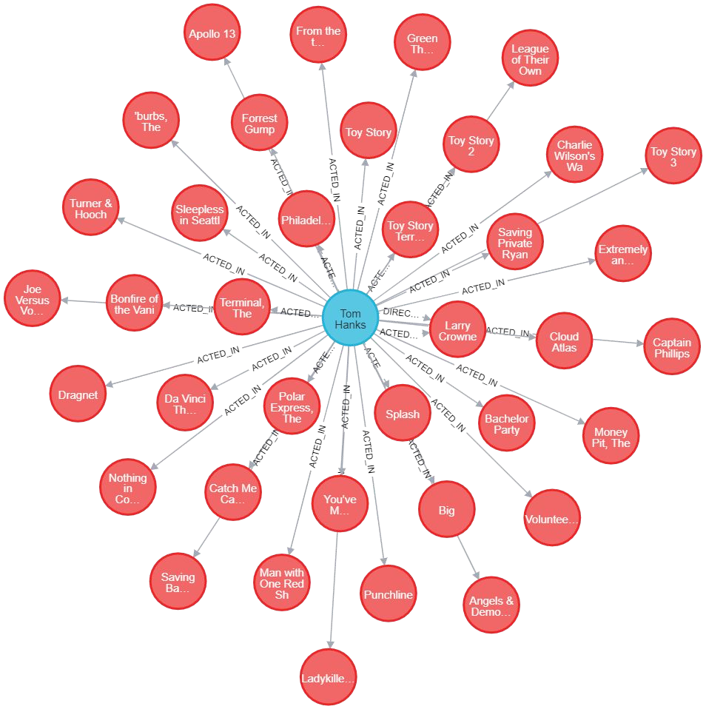

Slide 43
Have a go!
1. Find a Movie you like.
MATCH (m:Movie) RETURN m.title
2. Use the ACTED_IN relationship to find who acted in the movie.
MATCH (m:Movie {title: “???”})-[:??????]->(p:Person) RETURN p.name
3. Use the DIRECTED relationship to find who directed the movie
MATCH (m:Movie {title: “???”})-[:??????]->(p:Person) RETURN p.name

Slide 44
Wrili⭲ą

Slide 45
Writing to Neo4j
// Find or create using MERGE
MERGE
(p:Person {name: "Tom Hanks"})

Slide 46
Writing to Neo4j
// Find | or create using MERGE
MERGE | (p:Person {name: | "Tom | Hanks"})
MERGE | (m:Movie {title: | "Toy | Story"})

Slide 47
Writing to Neo4j
// Find | or create using MERGE
MERGE | (p:Person {name: | "Tom | Hanks"})
MERGE | (m:Movie {title: | "Toy | Story"})
MERGE | (p)-[r:ACTED_IN]->(m)

Slide 48
Writing to Neo4j
// Find or create using MERGE
(p:Person {name: "Tom Hanks"}) (m:Movie {title: "Toy Story"}) (p)-[r:ACTED_IN]->(m)
r.roles = "Woody"
MERGE
MERGE
MERGE
SET

Slide 49


Slide 50
Have a go!
1. Create a Person node for yourself
MERGE (me:Person{name: “??????”})
2. Give yourself a role in a movie by creating an ACTED_IN
relationship
MATCH (me:Person{name: “??????”})
MATCH (m:Movie{title: “??????”})
MERGE (me)-[r:??????]->(m) SET r.role = “???????”
3. Find your role in the movie
MATCH (p:Person{name:”??????”})-[r:ACTED_IN]->(????) RETURN ?.?????

Slide 51
Dala model

Slide 52
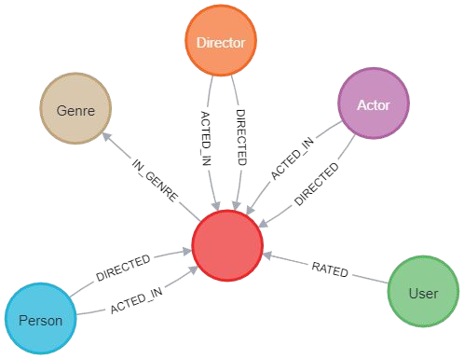
Take a look!
CALL db.schema.visualization()

Slide 53
The Golden Rule
Noun
Verb
Noun

Slide 54
(Noun)-[Verb]->(Noun)
Person
Advertised On
Platform

Slide 55
…and knowing when to break it
Person
Advertised On
Platform

Slide 56
…and knowing when to break it
Person
Advertised On
Platform
You may need to build out a network around this fact

Slide 57
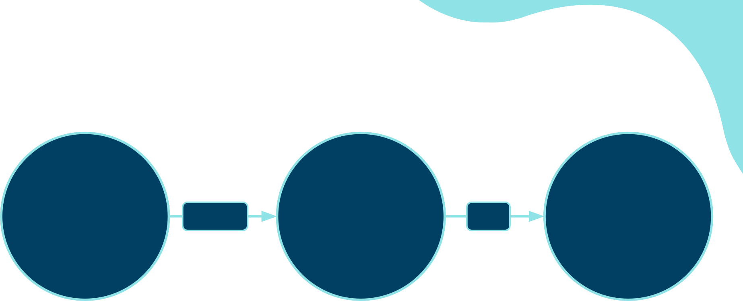
…and knowing when to break it
Person
Purchased
Advertisement
On
Platform

Slide 58
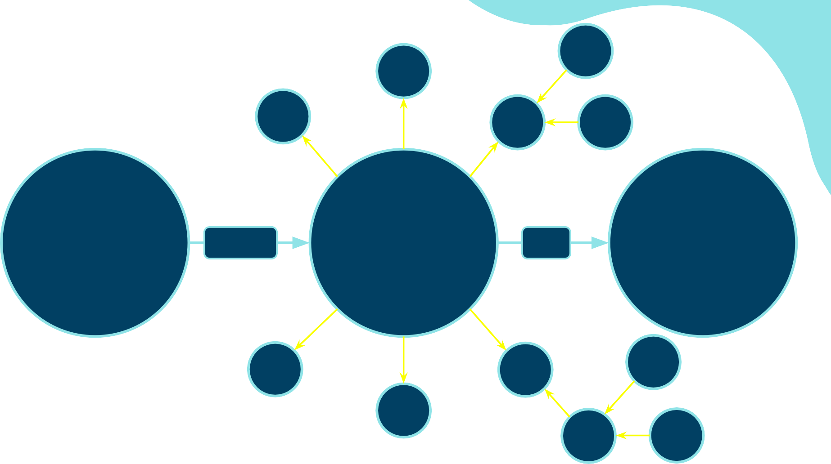
(Noun)--(Verb)--(Noun)
Person
Purchased
Advertisement
On
Platform

Slide 59
Properties
Person
Person
name: Martin lives: UK
Last_seen: 2024-06-01
name: Alex lives: Germany purchases: 5

Slide 60
6⭲sweri⭲ą queslio⭲s

Slide 61

Which is the best Matrix film?

Slide 62
Have a go!
Use the rating property on the RATED relationship to find:
1. The movie with the most ratings.
MATCH (m:Movie)<-[?:?????]-(u:User)
RETURN m.title, count(?.?????) AS ratings ORDER BY ratings DESC
2. The top 10 movies based on average rating.
MATCH (m:Movie)<-[?:?????]-(u:User)
RETURN m.title, ???(?.?????) AS avgRating LIMIT 10
ORDER BY ????? DESC

Slide 63
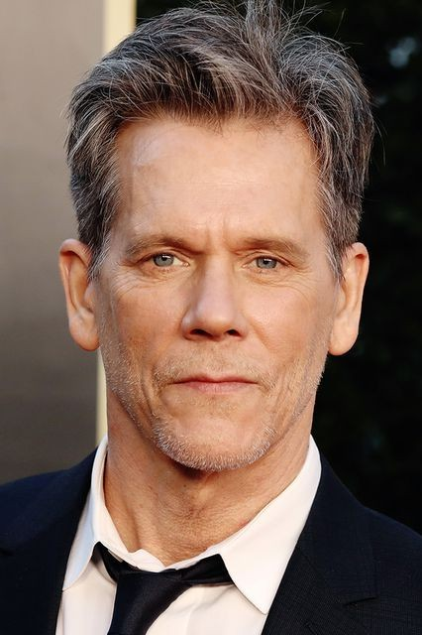
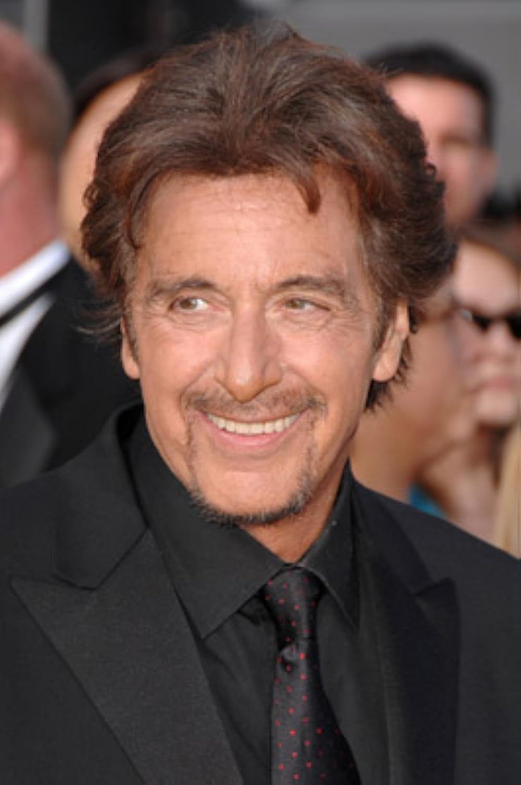
Kevin Bacon <-> Al Pacino

Slide 64
Have a go!
Use the shortestPath
function to find:
1. The connection
between 2 Movie nodes.
MATCH (m1:Movie {title:"??????"})
MATCH (m2:Movie {title:"??????"})
MATCH p = shortestPath((m1)-[:ACTED_IN*]-(m2)) RETURN p
2. The connection between a random User and Kevin Bacon
MATCH (p:Person {title:"Kevin Bacon"}) MATCH (?:User {name:"Angela Thompson"}) MATCH p = ?????((?)-[*]-(?))
RETURN p

Slide 65
Veclor i⭲dexes

Slide 66


Apple - Technology or Fruit

Slide 67
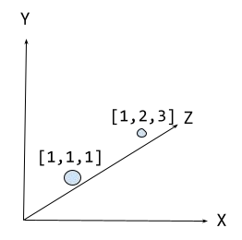
Vectors

Slide 68
Embeddings
“apple”
[0.0077788467, -0.02306925, -0.007360777, -0.027743412,
-0.0045747845, 0.01289164, -0.021863015, -0.008587573,
0.01892967, -0.029854324, -0.0027962727, 0.020108491,
-0.004530236, 0.009129008, …]

Slide 69
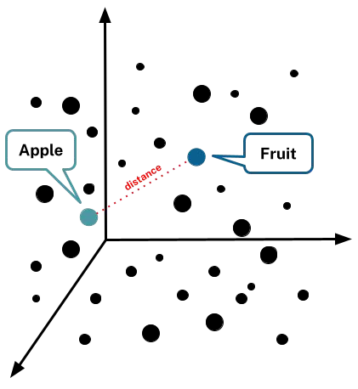
Vector search

Slide 70
Movie plots
https://data.neo4j.com/rec-embed/plot_load.cypher
LOAD CSV WITH HEADERS
FROM 'https://data.neo4j.com/rec-embed/movie-plot-embeddings-1k.csv' AS row
MATCH (m:Movie {movieId: row.movieId})
CALL db.create.setNodeVectorProperty(m, 'plotEmbedding', apoc.convert.fromJsonList(row.embedding))

Slide 71
Vector index
https://data.neo4j.com/rec-embed/plot_create_index.cypher
CREATE VECTOR INDEX moviePlots IF NOT EXISTS
FOR (m:Movie)
ON m.plotEmbedding OPTIONS {indexConfig: {
`vector.dimensions`: 1536,
`vector.similarity_function`: 'cosine'
}}

Slide 72
Query vector
https://data.neo4j.com/rec-embed/plot_query.cypher
MATCH (m:Movie {title: 'Toy Story'})
CALL db.index.vector.queryNodes('moviePlots', 6, m.plotEmbedding)
YIELD node, score
RETURN node.title, node.plot, score

Slide 73
Movie plots
https://data.neo4j.com/rec-embed/plot_load.cypher
https://data.neo4j.com/rec-embed/plot_create_index.cypher https://data.neo4j.com/rec-embed/plot_query.cypher

Slide 74


Learn more with
Completely Free
Hands-on Courses
teaching Neo4j Fundamentals, Cypher, Drivers and Graph Data Science
Curated Learning Paths catering for everyone from beginners to experts
Free Certifications
graphacademy.neo4j.com

